Slide 1

A new generation of DNA hidden repeats detection algorithm and its application for isochore research
CAPSTONE PHASE A
25-2-R-8
Students: Khalel Mnsor || Fatmeh Zoabi
Supervisor: Dr. Zakharia Frenkel

Slide 2








Table Of Contents
Problem Overview
Motivation
Definitions
Weak/Strong Segment Example
Problem/Challenge and solution
Step-by-Step Algorithm
Pseudocode Summary
Conclusion

Slide 3
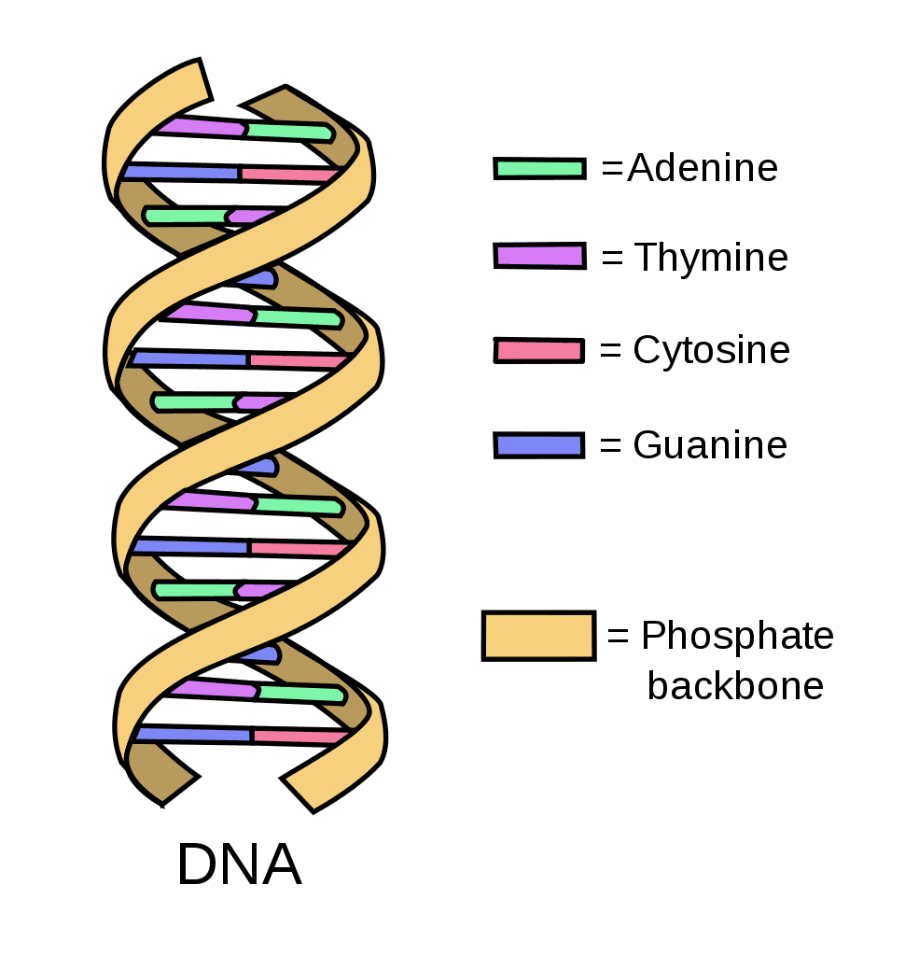
Problem Overview
Biological DNA sequences contain many regions with hidden simple repeats — short repeated sequences with multiple variations.
Although many such regions have been identified, a statistically robust and accurate algorithm for the detection and precise mapping of the hidden repeats has not yet been developed.
One of the key challenges is that the signal level of hidden repeats is often very low — making it hardly distinguishable from other overlapping signals in the DNA or from biological noise.

Slide 4



Motivation
This project continues the work of a previous research, in which a segmentation-based algorithm was proposed to detect hidden repeat patterns in DNA using dominant k-mers and statistical testing.
Our goal is to refine and expand the algorithm to improve its accuracy and biological interpretability — for example, by using advanced statistical methods to better filter noise. We also aim to study the relationship between hidden repeats and isochore structures by analyzing GC content and segment scores.
The algorithm is designed to be computationally efficient, allowing analysis of
large genomic data and make map comparison between individuals. This may reveal biological differences, explain disease risk, and uncover links between hidden repeats and genomic instability.

Slide 5
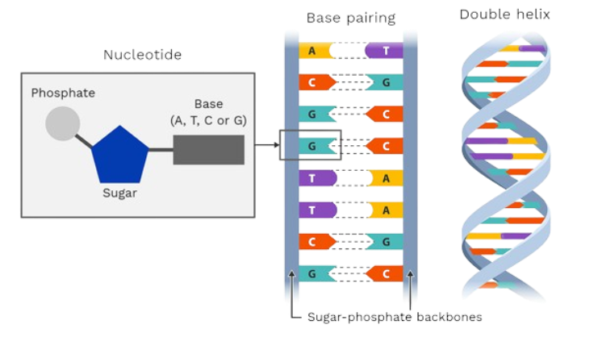
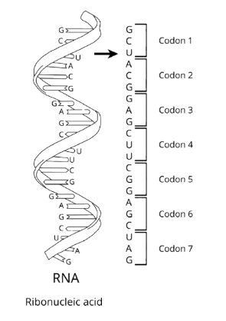
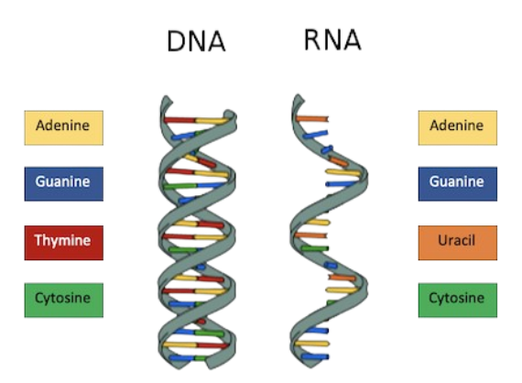
Definitions
Biological Definitions:
DNA: A molecule composed of nucleotides (A, T, C, G) that stores genetic information in all living organisms.
Triplets / Codons: DNA is read in groups of 3 letters (called triplets or codons).

Slide 6
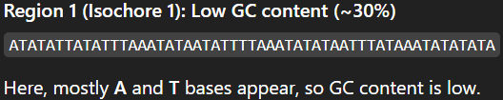
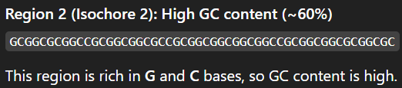
Definitions(contd.)
3. Isochore: A large region of DNA with relatively
uniform GC content — that is,
the percentage of Guanine (G) and Cytosine (C)
bases stays consistent throughout the region.
Key Question: We want to investigate whether isochore formation is influenced by hidden repeats — in other words, are these regions uniform because of the presence of repeated DNA sequences?

Slide 7
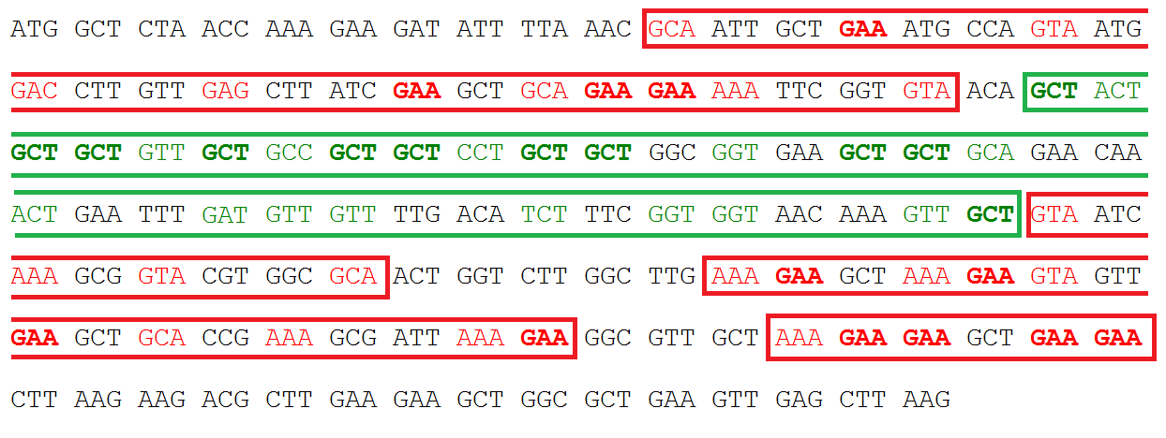
4. Hidden Repeats: DNA sequences that are repetitive in nature but difficult to detect due to mutations, variability, or low complexity. Example 1: ATG ATG ATG CGT → ATG || Example 2: ATG ATC ATG CGT → ATG
Definitions(contd.)

Slide 8
Definitions(contd.)
Statistical Definitions:
Segment Score A numeric value indicating how similar a DNA segment is to a specific repeating pattern based on base frequencies.
P-value A number between 0 and 1 that indicates how likely it is to observe the current results if there were no real effect; lower values suggest stronger evidence against randomness (In short probability of seeing the results just by random chance).

Slide 9
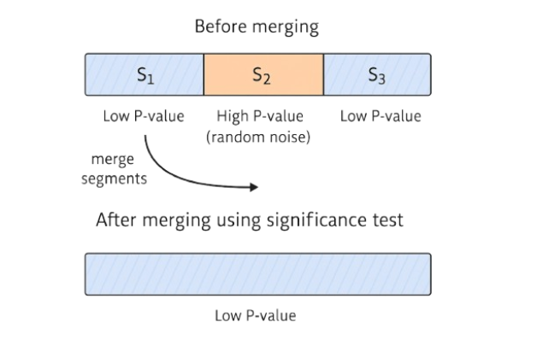
Example Of Strong/Weak 3-mer Segment:
S₁ – Strong Segment (Low P-value) — 7 codons
“ATG ATG ATG ATG ATG ATG ATG”
Repeat is clear: ATG
S₂ – Weak Segment (High P-value / Noise) — 7 codons
“GTC AAG CCT TGA GAC CAA TTG”
Repeat NOT clear
S₃ – Strong Segment (Low P-value) — 7 codons
“ATG ATG ACG ATG AAG ATG ATG”
Repeat is clear: ATG

Slide 10
What is the problem?
In DNA segmentation, two strong repeats may be separated by a short, weak segment — often just random noise, not a true structural change.
Why is this a challenge?
If we split at the weak region, we risk over-segmenting and breaking a real repeat.
Solution:
We use p-values to evaluate each segment. If a weak middle segment has a high p-value,
and its neighbors have low p-values,
We merge them into one repeat region. This statistical merging is our key innovation.

Slide 11
Algorithm: Hidden Repeat Detection Using Dominant k-mer Segmentation with Binomial Testing
Objective
To detect hidden repeat regions in DNA sequences by analyzing dominant k-mer patterns across fixed-length segments, and resolving ambiguous regions using statistical testing.
Flow Chart Diagram:
Input DNA
Segmenting
k-mer Occurrence Matrix
Noise Detection
and filter noise
Find the Representative Word and Calculate the segment score
P-value Tests
Merging

Slide 12
Step-by-Step Algorithm
1. Input: (DNA sequence) S, (Minimal Segment length) L, (the maximum Word size) k,
(Other variables) α, τ1 , τ2
2. Segment the Sequence: Divide S into non-overlapping segments of length L.
In our next example we used 3-mer words:
Input:
S = GTGACGGTGTAGACGGTGACGGTGTGTGTAGACGGT
L = 12, k = 3, α = 0.05
S = GTGACGGTGTAG | ACGGTGACGGTG | TGTGTAGACGGT
Segment the Sequence:
Segment 1 (S₁): GTG ACG GTG TAG
Segment 2 (S₂): ACG GTG ACG GTG
Segment 3 (S₃): TGT GTA GAC GGT

Slide 13
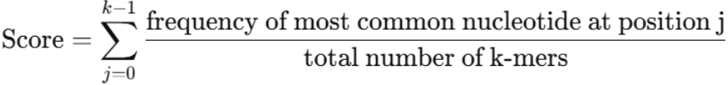
3. Generating the Occurrence Matrix for a DNA Segment and Calculate the Segment Score
4 × k matrix: rows = A |C | G |T , columns = k-mer positions (k=3 in our example)
Count nucleotide frequencies per position
Find the dominant k-mer (representative word)
Calculate the Segment Score:
For each position j, we compute the proportion of the most frequent nucleotide:
Example:
S = GTG|ACG|GTG|TAG
j = 0 ,1, 2
Position 2 | Position 1 | Position 0
0 | 1 | 1 | A
0 | 1 | 0 | C
4 | 0 | 2 | G
0 | 2 | 1 | T
G | T | G | Most frequent
Representative Word = GTG
4/4 | 2/4 | 2/4 | Segment Score
Segment Score=0.5+0.5+1=2.0

Slide 14
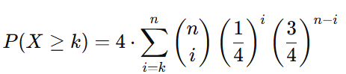
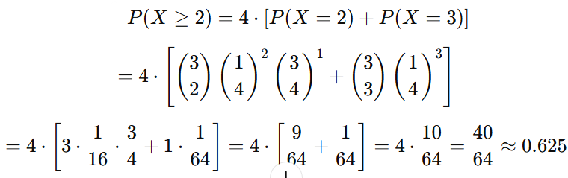
4. P-Value Calculation for Each Position
Evaluate statistical significance of each column using binomial distribution:
n = number of words in the segment
k = count of the most frequent nucleotide
Example:
Suppose column 0 in Occurrence Matrix contains:
Nucleotide | Count
A | 2
T | 1
C | 0
G | 0
n=3
K=2

Slide 15
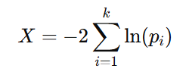
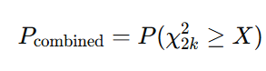
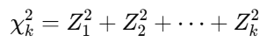
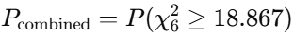
5. (Fisher's method) Combined Fisher P-value for the Entire Segment:
Combine k P-values (one per position):
Example: Let’s assume a segment has the following P-values for the three positions:
What Are We Actually Calculating?
We are finding the right-tail probability, which answers the question: “What is the probability that a chi-squared variable with 2k degrees of freedom will take on a value greater than or equal to 𝑋?”
Codon Position | P-value
Position 0 | 0.04
Position 1 | 0.20
Position 2 | 0.01
X = −2 · ( ln⁡(0.04) + ln⁡(0.20) + ln⁡(0.01) )
ln⁡(0.04) ≈ −3.2189 | ln⁡(0.20) ≈ −1.6094 | ln⁡(0.01) ≈ −4.6052
X = −2 · (−3.2189 − 1.6094 − 4.6052) = 18.867
We Calculate
K=3

Slide 16
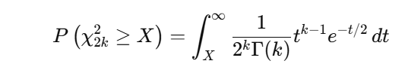
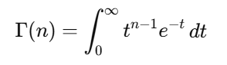
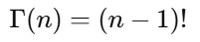
Method 1: Manual Calculation Using the Exact Formula (Hard Way)
(This is only true when n is a positive integer!.)

Slide 17
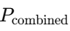
Method 2: Using Chi-squared Critical Value Tables
For example, with df = 6:
X>18.55 ⇒ p-value < 0.005
X<19.68 ⇒ p-value > 0.002
0.002 < ​ < 0.005
p-value | χ² critical value
0.10 | 10.64
0.05 | 12.59
0.01 | 16.81
0.005 | 18.55
0.002 | 19.68

Slide 18
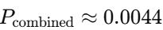
Method 3: Accurate Calculation Using Software
This can be calculated using statistical software or Python:
{
from scipy.stats import chi2
p_combined = chi2.sf(18.867, df=6)
print(p_combined) # Output 0.004394246244411314
}
So, the final combined P-value is approximately:

Slide 19
6. Merge Segments (Same Word)
If adjacent segments have same representative word → merge them.
Recalculate Segment Score and Combined P-value for merged segment.
7. Noise Detection
Criteria to merge across noisy segments:
Middle P-value: > τ₁ (e.g., τ1=0.1)
Neighbors' P-values: < τ₂ (e.g., τ2=0.01)
Case1: S2.word ≠ S1.word = S3.word
The p-value after the merge must be <= α (e.g., α=0.05)
(Optional) Case 2: S2.word ≠ S1.word ≠ S3.word
If (S1-S2 > α and S2-S3 < α) → Merge (S1-S2)
Else If (S1-S2 < α and S2-S3 > α) → Merge (S2-S3)
Else → Merge the one that has less impact on the p-value.
Example:
Combined P-value | Word | Segment
0.003 | GTG | S1
0.24 | ACG | S2
0.005 | GTG | S3
Merge S1–S2–S3 (S₂ is noise)

Slide 20
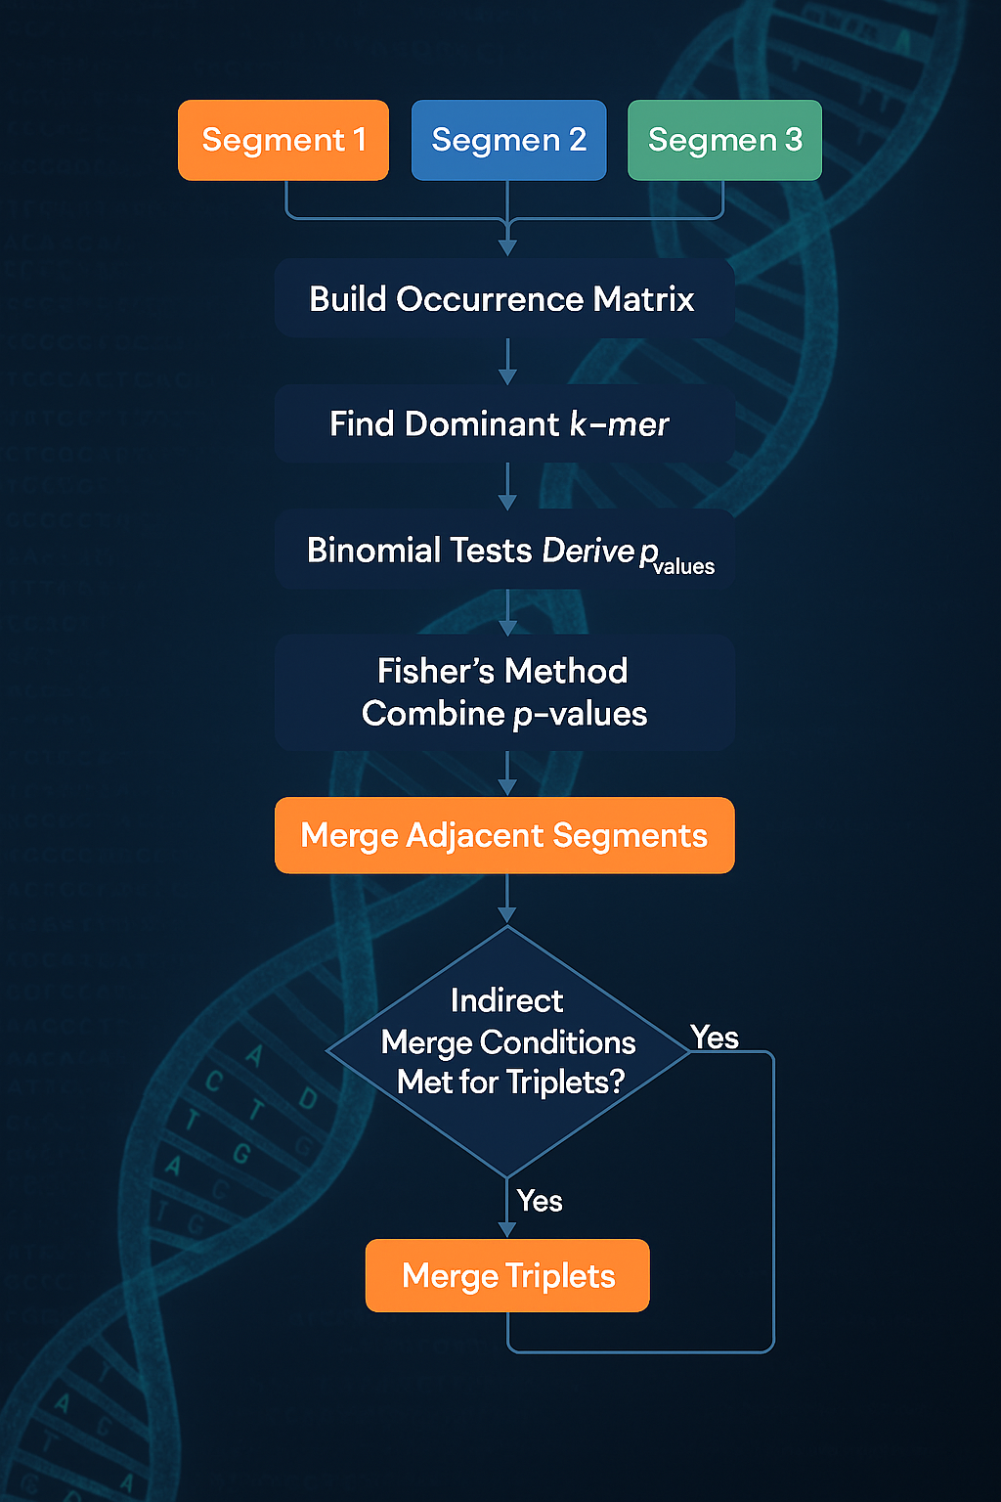
Pseudocode Summary – Hidden Repeat Detection Algorithm
for segment in segments:
build_occurrence_matrix(segment)
representative_word = get_dominant_kmer(matrix)
p_values = binomial_test(matrix)
p_combined = fisher_method(p_values)
merge_adjacent_same_word(segments)
for triplet in segments:
if indirect_merge_conditions_met(triplet):
merge_triplet(triplet)

Slide 21
Research Plan
Map Hidden Repeats within Isochores from DNA sequences.
Use data from genomic databases.
Analyze dozens of genomes from different species (e.g., monkey, dog).
Compare maps to examine how well they align with known isochore structures.
How will it be done?
Build Hidden Repeat maps for each genome (as a data structure).
Calculate distances between maps to measure similarity (e.g., Jaccard Index ,Cosine similarity).
Compare segmentations (fragmentations) between species.
Use an existing segmentation comparison algorithm to assist.

Slide 22
🧬Conclusion
Hidden repeats are subtle patterns in DNA that traditional tools often miss.
They may play a key role in large-scale structures like isochores.
Our method uses statistical significance (p-values) to detect hidden repeats.
This approach helps us avoid over-segmentation and preserve true biological patterns.
By uncovering hidden repeats, we gain deeper insight into genome structure and its biological meaning.
Enabling comparison across species, revealing biological differences and disease-related patterns.

Slide 23

Any Questions?
THANK YOU!

